Slide 1

递归练习
余力
buaayuli@ruc.edu.cn

Slide 2
#672. 快速排序函数
void quicksort( int ary[ ], int left, int right ) {
}
if(left>=right) return;
int m=partition(ary, left, right);
quicksort(ary, left, m-1);
quicksort(ary, m+1, right);

Slide 3
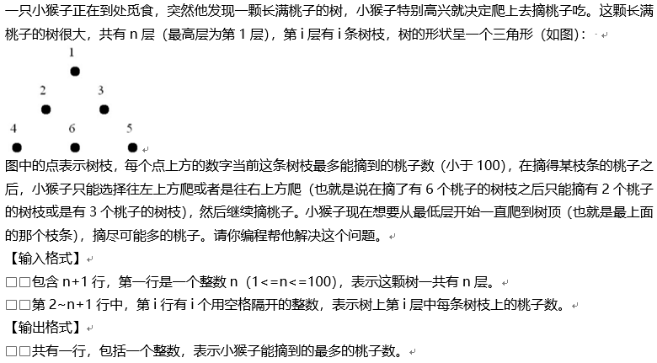
#117 摘桃子

Slide 4
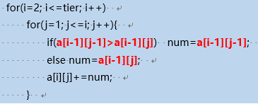
int zai(int x, int y)
{ int topleft, topright;
if (x==1) return a[x][y];
else
if(y==1)
{ from_topright=a[x][y]+zai(x-1,y);
return from_topright;
}
else
{ from_topleft =a[x][y]+zai(x-1,y-1);
from_topright=a[x][y]+zai(x-1,y);
if (from_topleft>from_topright) return from_topleft;
else return from_topleft;
}
}
纯数组
return a[x][y]+zai(x-1,y)
纯递归
左上：a[x][y]+zai(x-1,y-1);
右上：a[x][y]+zai(x-1,y)
return max(左上、右上)
计算超时！！
Notes:
计算超时

Slide 5
int zai(int x, int y) {
int topleft, topright;
if (taozi[x][y] == -1) {
if (x == 1) taozi[x][y] = a[x][y];
else if (y == 1)
taozi[x][y] = a[x][y] + zai(x - 1, y);
else {
topleft = a[x][y] + zai(x - 1, y - 1);
topright = a[x][y] + zai(x - 1, y);
if (topleft > topright) taozi[x][y] = topleft;
else taozi[x][y] = topright;
}
}
return taozi[x][y];
}
int taozi[101][101];
-1
taozi[x][y] =a[x][y]
分三种情况
直接或间接
告诉答案
taozi[x][y] = a[x][y]+zai(x-1,y)
左上：a[x][y]+zai(x-1,y-1);
右上：a[x][y]+zai(x-1,y)
taozi[x][y] =比较 左上、右上
递归+数组

Slide 6
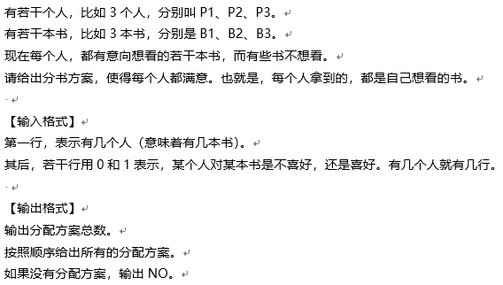
#202 分书问题

Slide 7
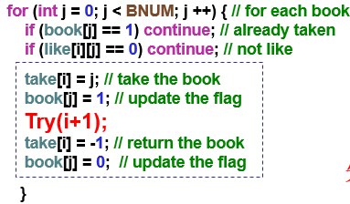
int Like[10][10], Fangan[10000][10] = {0}, Book[10] = {0}, Take[10];
void Try(int i) {
if (i == n) {
for (int j = 0; j < n; j++)
Fangan[count][j] = Take[j];
count++;
} else
for (int j = 0; j < n; j++)
if ((Like[i][j] != 0 ) && (Book[j] != 1)) {
Take[i] = j;
Book[j] = 1;
Try(i + 1);
Book[j] = 0;
}
}
搜索

Slide 8
void input() {
int like_value;
scanf("%d", &n);
for (int i = 0; i < n; i++) {
scanf("%d", &like_value);
for (int j = 0; j < n; j++) {
Like[i][n - j - 1] = like_value % 10;
like_value /= 10; }
}
}
int main() {
input();
Try(0);
output();
return 0;
}
void output() {
if (count == 0) printf("NO");
else { printf("%d\n", count);
for (int i = 0; i < count; i++) {
for (int j = 0; j < n; j++)
printf("B%d", Fangan[i][j] + 1);
printf(“\n”); }
}
}

Slide 9
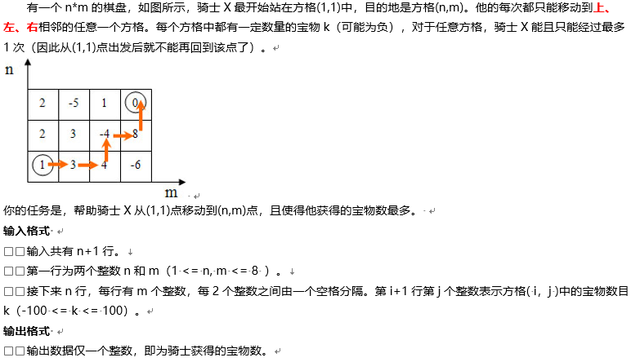
#126 Travel

Slide 10
void Try(int x, int y) {
if ( x < 1 || x > n || y < 1 || y > m || used[x][y] ) return;
mine += value[x][y];
used[x][y] = 1;
if ( x == n && y == m ) // 当前探索完毕
if (sum < mine) sum = mine;
else {
Try(x + 1, y); // 上
Try(x, y - 1); // 左
Try(x, y + 1); // 右
}
mine -= value[x][y];
used[x][y] = 0;
}
0、排队越界+不可用
1、先用
Try(1, 1) ?
Try(0, 0) ?
2.1、终点到站
2.2、直接探索
3、回朔
Notes:
探索后判断

Slide 11
void Try(int x, int y) {
mine += value[x][y];
used[x][y] = 1;
if ( x == n && y == m )
if (sum < mine) sum = mine;
else {
Try(x + 1, y); // 上
Try(x, y - 1); // 左
Try(x, y + 1); // 右
}
mine -= value[x][y];
used[x][y] = 0;
}
Try(1, 1)
1、先用
2.1、终点到站
2.2、判断探索
if (x + 1 <= n && !used[x + 1][y]) Try(x + 1, y);
if (y - 1 >= 1 && !used[x][y - 1]) Try(x, y - 1);
if (y + 1 <= m && !used[x][y + 1]) Try(x, y + 1);
3、回朔
Notes:
探索后判断

Slide 12
void Try(int x, int y) {
// 第1步 探索
mine += a[x][y]; used[x][y] = 1;
value[step] = a[x][y]; step++;
// 第2步 判断+递归
if ( x == n && y == m ) {
if (best_mine < mine) {
best_mine = mine; best_step = step - 1;
for (int j = 1; j <= best_step; j++)
best_value[j] = value[j]; }
} else {
if (x + 1 <= n && !used[x + 1][y]) Try(x + 1, y);
if (y - 1 >= 1 && !used[x][y - 1]) Try(x, y - 1);
if (y + 1 <= m && !used[x][y + 1]) Try(x, y + 1);
}
// 第3步 回朔
mine -= a[x][y]; used[x][y] = 0; step--;
}
输出最优值
Notes:
输出最优值

Slide 13
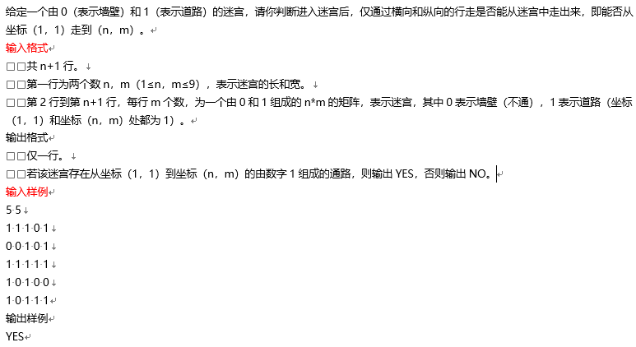
#122 迷宫

Slide 14
for (i = 0; i < R; i++)
for (j = 0; j < C; j++)
search(i, j, 0);
void Try(int x, int y) {
if (x == n - 1 && y == m - 1)
{ find = 1; //判断条件
return; }
used[x][y] = 0; //使用 这一点标记搜索过
if (y != 0 && used[x][y - 1] == 1) search(x, y - 1);
if (y != m - 1 && used[x][y + 1] == 1) search(x, y + 1);
if (x != 0 && used[x - 1][y] == 1) search(x - 1, y);
if (x != n - 1 && used[x + 1][y] == 1) search(x + 1, y);
}
不回朔
分别探索四个方向
条件：不会出界、是道路

Slide 15
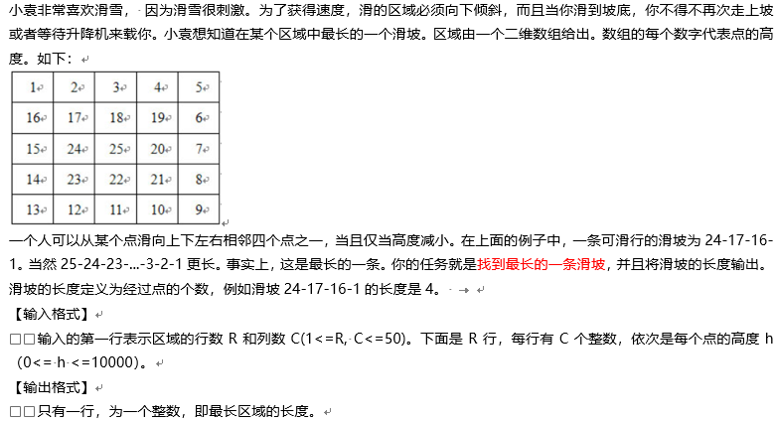
#124 滑雪

Slide 16
void Try( int x, int y, int len ) {
if (x < 1 || y < 1 || x > r || y > c) return;
else {
len++;
if (len > max_value) max_value = len;
if ( a[x][y] > a[x - 1][y] ) Try(x - 1, y, len);
if ( a[x][y] > a[x + 1][y] ) Try(x + 1, y, len);
if ( a[x][y] > a[x][y - 1] ) Try(x, y - 1, len);
if ( a[x][y] > a[x][y + 1] ) Try(x, y + 1, len);
}
}
Try(i, j, 0)

Slide 17
void Try(int x, int y, int len) {
len ++;
if (len > max_value) max_value = len;
if (a[x - 1][y] < a[x][y] && x - 1 > 0 ) Try(x - 1, y, len);
if (a[x + 1][y] < a[x][y] && x + 1 <= c) Try(x + 1, y, len );
if (a[x][y - 1] < a[x][y] && y - 1 > 0 ) Try(x, y - 1, len);
if (a[x][y + 1] < a[x][y] && y + 1 <= r) Try(x, y + 1, len);
}
Try(i, j, 0)
不能<=
Notes:
不能<=

Slide 18
void Try(int x, int y, int len) {
int move[4][2] = {{1, 0}, {-1, 0}, {0, 1}, {0, -1}};
len++;
for (int i = 0; i < 4; i++)
{ used[x][y]++;
nx = x + move[i][0]; ny = y + move[i][1];
if ( nx >= 0 && nx < R && ny >= 0 && ny < C )
if (!used[nx][ny] && data[nx][ny] <= data[x][y])
search(nx, ny, len);
if (len > max_len) max_len = len;
used[x][y]--;
}
return;
}
探索每一个方向
条件：不会出界、没探过、数值小
可以<=

Slide 19
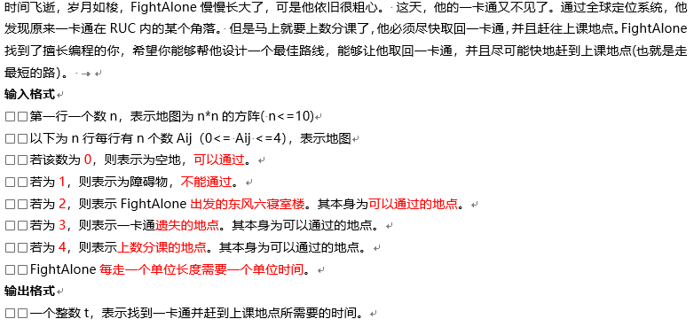
#437 寻找一卡通

Slide 20
int main() {
scanf("%d", &n);
int i = 0, j = 0, x1, y1, x2, y2;
while (i < n) {
j = 0;
while (j < n) {
scanf("%d", &a[i][j]);
if (a[i][j] == 2) { x1 = i; y1 = j; }
if (a[i][j] == 3) { x2 = i; y2 = j; }
j++; }
i++; }
min_distance = 100;
walk(x1, y1, 3); //到分值为3的点
int dis1 = min_distance;
min_distance = 100;
walk(x2, y2, 4); //到分值为4的点
int dis2 = min_distance;
printf("%d", dis2 + dis1);
return 0;
}
int a[11][11] = {0};
int used[11][11] = {0};
int step = 0;
int min_distance;
找出发点
进行搜索
Notes:
找好出发点

Slide 21
void walk(int x, int y, int goal) {
if (a[x][y] == goal)
if (step < min_distance) min_distance = step;
else if (used[x][y] == 0) {
step++; used[x][y] = 1;
if (y < n - 1 && a[x][y + 1] != 1) walk(x, y + 1, goal);
if (x < n - 1 && a[x + 1][y] != 1) walk(x + 1, y, goal);
if (y > 0 && a[x][y - 1] != 1) walk(x, y - 1, goal);
if (x > 0 && a[x - 1][y] != 1) walk(x - 1, y, goal);
step--; used[x][y] = 0;
}
}
先用
探索
四个
方向
回朔

Slide 22

练习
#163 最大岛屿
#320 物体称重

Slide 23
谢谢大家！

